Slide 1


WE KEEP YOU PEDALING
PRESENTED BY
SAYOOJ R
01/2025
MOTORCYCLE

Slide 2

Problem Statement
You are working as a data analyst at Jensen's, craft SQL queries to derive insights on customer behavior, staff performance, inventory management, and store operations.
MOTORCYCLE

Slide 3
SOLUTION STATEMENT
As a data analyst at Jensen's, the objective is to extract actionable insights from the company's database by leveraging SQL queries. Below is a structured approach to addressing each area of interest :
Customer Behaviour Analysis :
Understanding customer preferences, purchase patterns, and engagement trends is essential for targeted marketing and personalized customer experiences.
Staff Performance Evaluation :
Monitoring employee performance helps optimize efficiency and reward productivity.
Inventory Management :
Effective inventory management ensures optimal stock levels and minimizes wastage or stockouts.
Store Operations :
Optimizing store-level operations enhances overall efficiency and profitability.

Slide 4
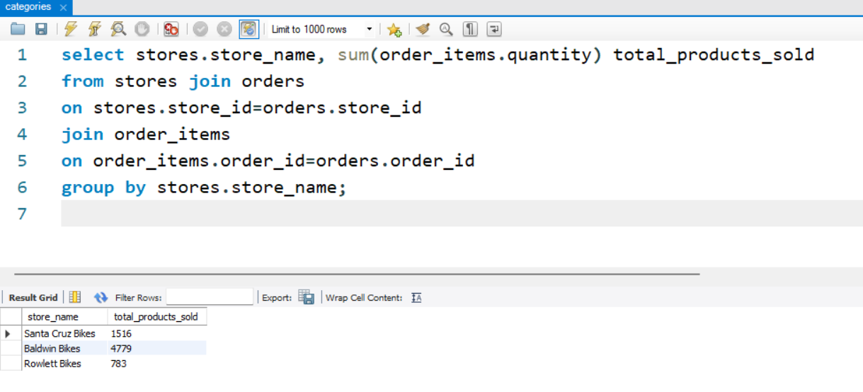
1. Find the total number of products sold by each store along with the store name.

Slide 5
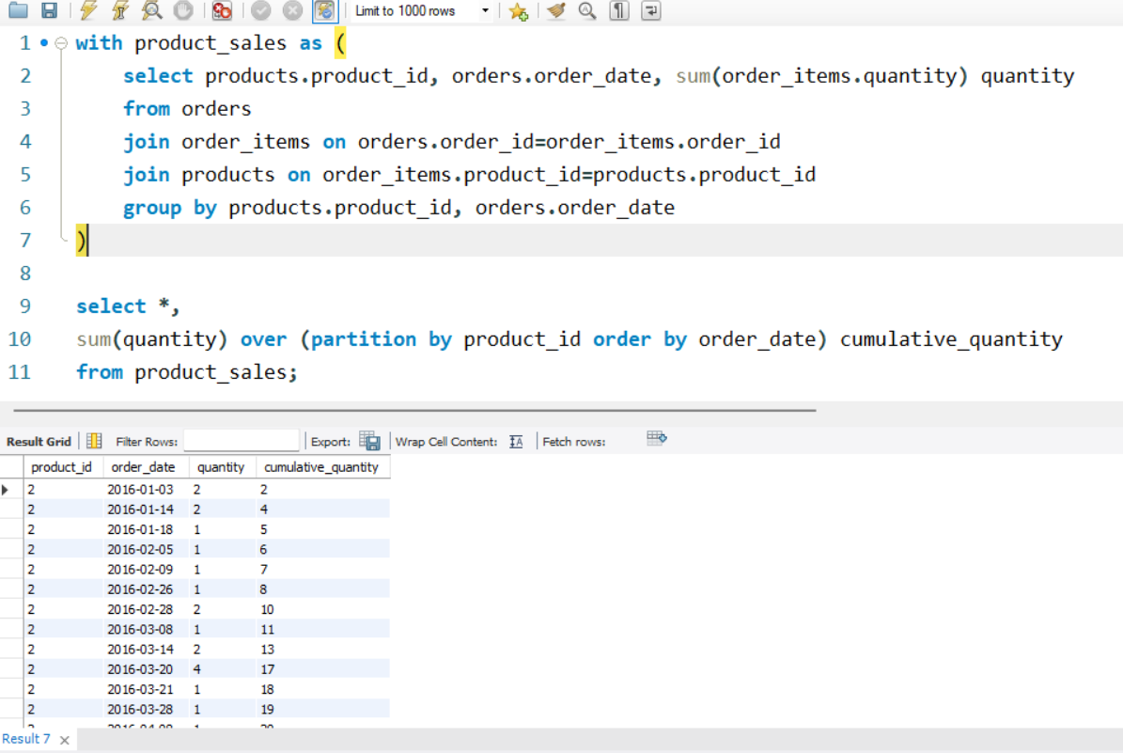
2. Calculate the cumulative sum of quantities sold for each product over time.

Slide 6
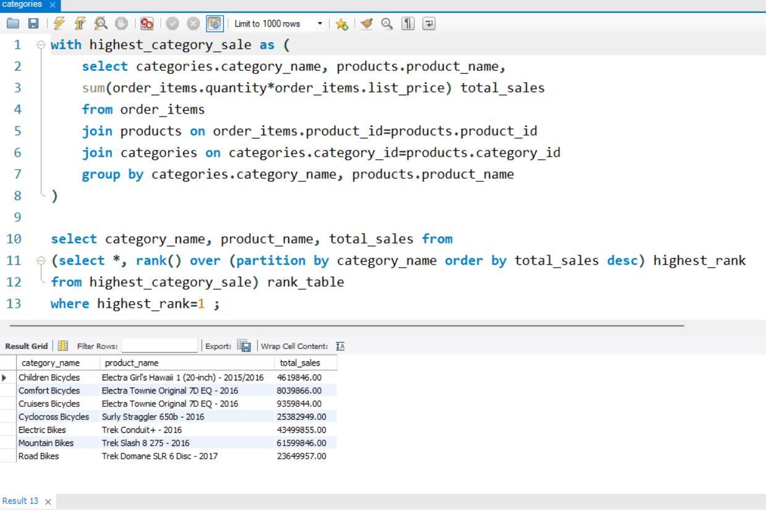
3. Find the product with the highest total sales (quantity * price) for each category.

Slide 7
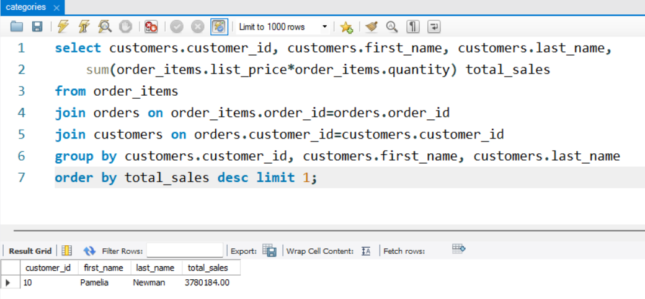
4. Find the customer who spent the most money on orders.

Slide 8
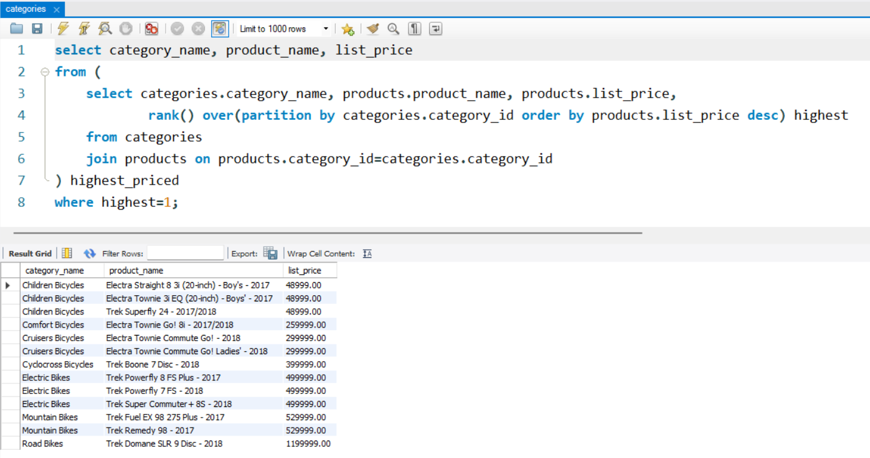
5. Find the highest-priced product for each category name.

Slide 9
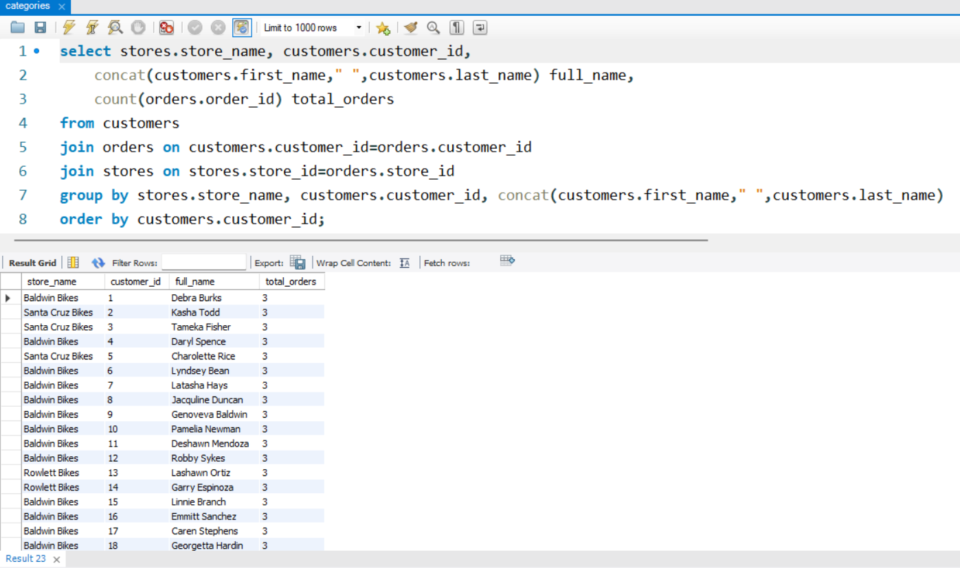
6. Find the total number of orders placed by each customer per store.

Slide 10
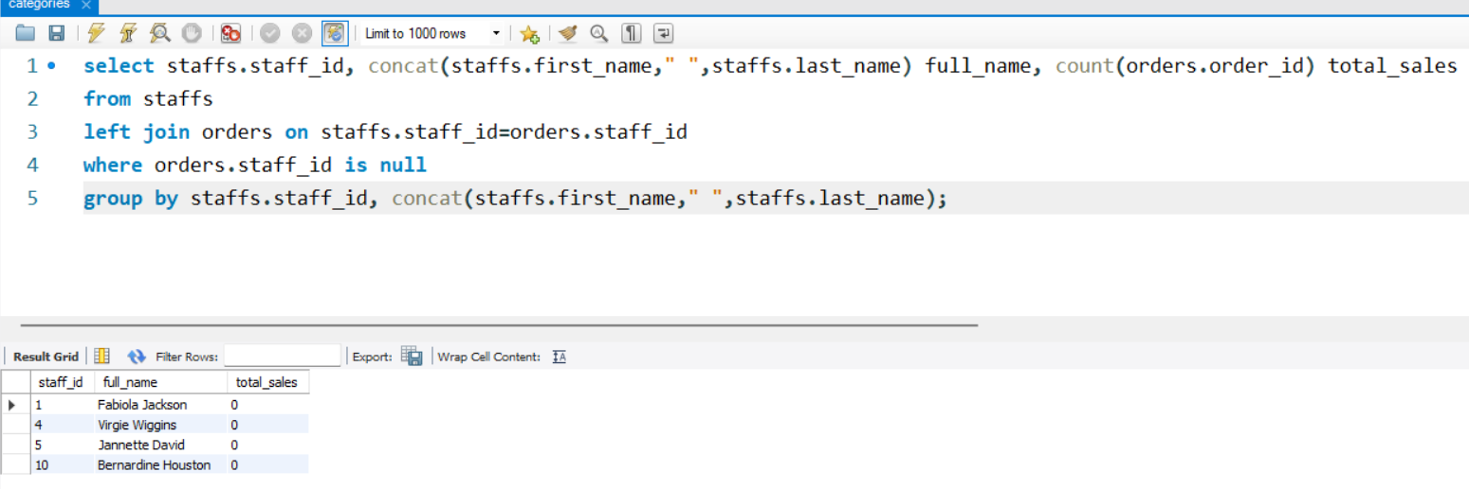
7. Find the names of staff members who have not made any sales.

Slide 11
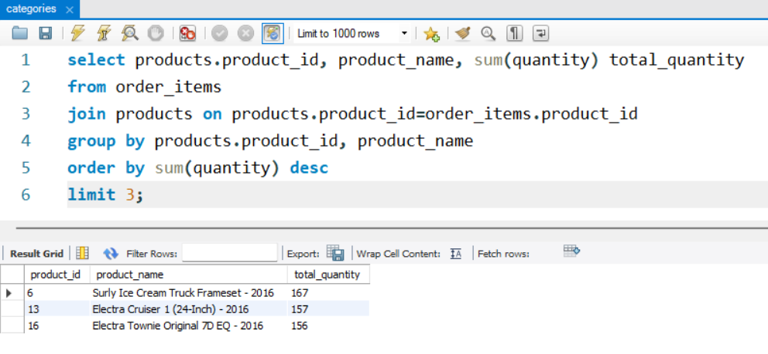
8. Find the median value of the price list.

Slide 12
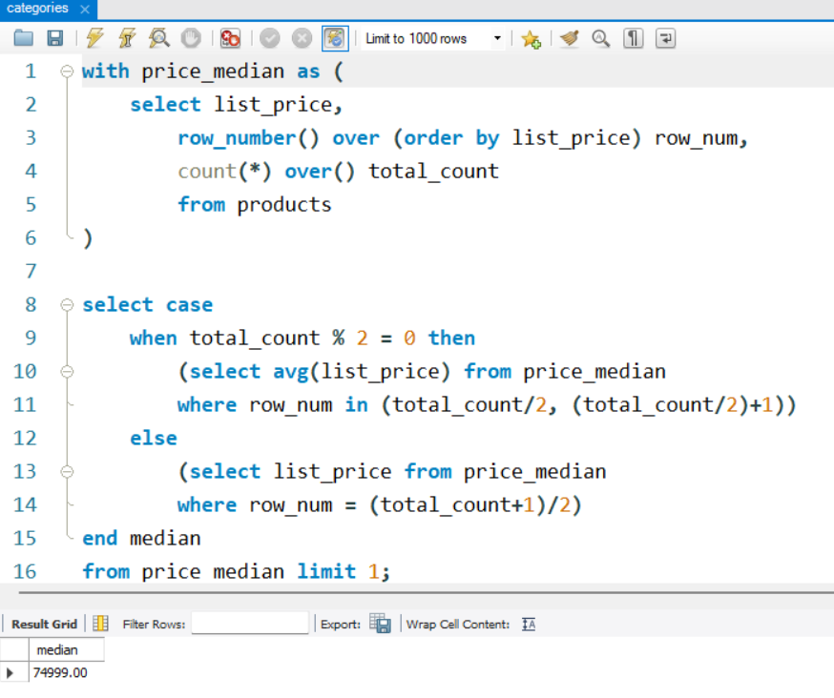
9. Find the median value of the price list.

Slide 13
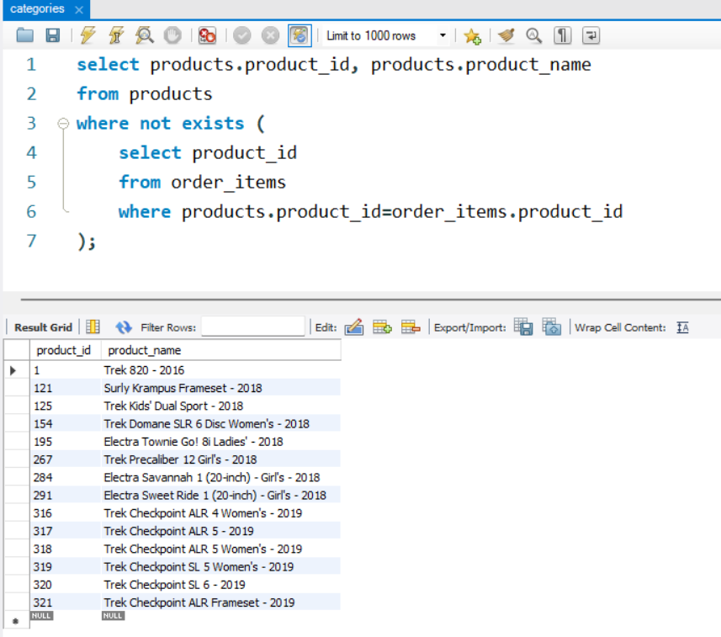
10. List all products that have never been ordered. (use Exists)

Slide 14
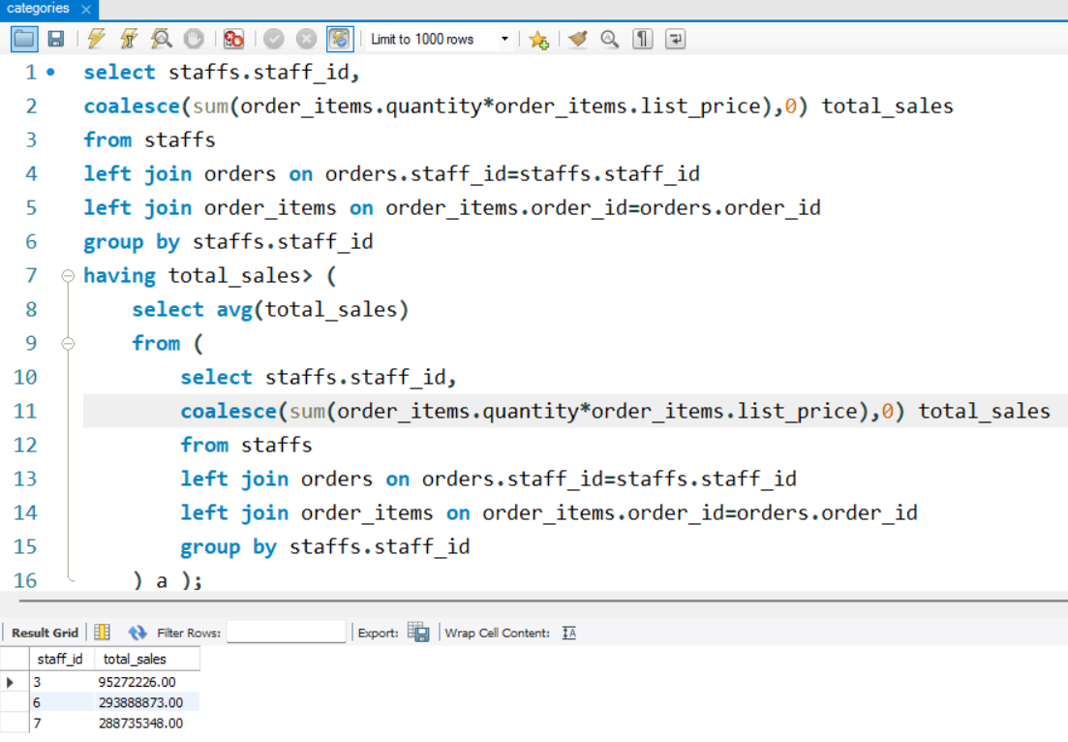
11. List the names of staff members who have made more sales than the average number of sales by all staff members.

Slide 15
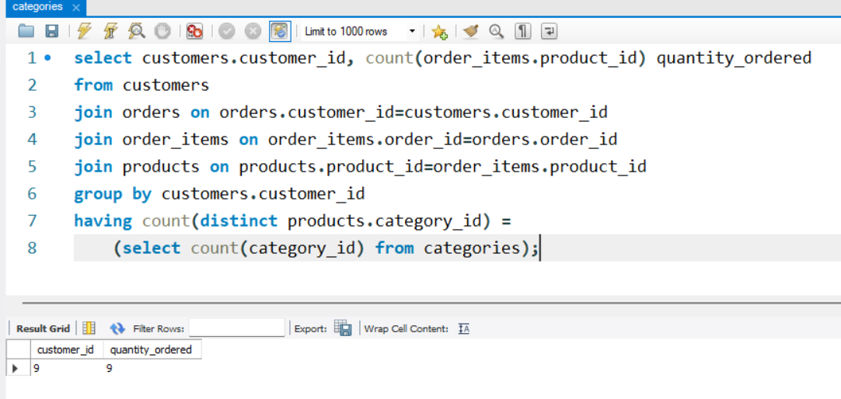
12. Identify the customers who have ordered all types of products (i.e., from every category).

Slide 16

A PICTURE IS WORTH
A THOUSAND WORDS
THANK YOU

